Slide 1
President & Vice President Report & Discussion
April 7, 2019

Slide 2
Platinum Excel Award

Slide 3
Virginia was 6th among all state councils for total annual contributions to the Foundation in 2018 (our total was $12,714).
In 2018 the Foundation awarded $8,500 in scholarships to nine HR professionals in Virginia.
Congratulations also to NOVA SHRM which was 21st among all chapters with $5,275 in contributions to the Foundation!

Slide 4
BETTER WORKPLACES, BETTER WORLD
Notes:
Just a few weeks ago, SHRM launched the Getting Talent Back To Work Initiative and Pledge. The goal of this initiative is to drive awareness of the issue and persuade employers and hiring managers to create a viable employment opportunities for workers with a criminal record. This initiative calls on business leaders to pledge to consider hiring qualified individuals for job opportunities regardless of their criminal record . . . giving those who deserve it a second chance.
SHRM believes that people who have made mistakes and paid their debt to society for their actions deserve a fair chance to bring their much-needed skills back into the workplace, especially at a time when American employers face a critical talent shortage.
Giving a deserving person a second chance is not only the right thing to do, it is becoming a business imperative.

Slide 5
STUDENTS AT CONFERENCE
James Madison University
Liberty University
Old Dominion University – sponsoring Emerging Professionals reception
Frostburg State University, MD

Slide 6
Engaging At-Large Members
HR Virginia booth in the Exhibit Hall

Slide 7
Tours Available – check email
Wilson Workforce & Rehabilitation Center is mentioned in the article "Scaling Up Skills" in the Spring 2019 edition of the SHRM HR Magazine.”
https://www.shrm.org/hr-today/news/hr-magazine/spring2019/pages/default.aspx
Nate Mahanes contact info is: cell (434) 515-0061 email nate.mahanes@dars.virginia.gov

Slide 8
POST CONFERENCE SURVEY FEEDBACK
96 registrants; 88 attendees; 33 survey respondents (37.5% response rate)
Conference overall: 87% rated “excellent” or “very good”
Net promoter (would you recommend to/for other volunteer leaders?): 96%
PRO: Location/venue
CON: Lack of space during dinner/lunch
Staunton, Virginia
January 10-12, 2019

Slide 9
POST CONFERENCE SURVEY FEEDBACK
“Great information.” “Snow impacted attendance” [several comments]
Everything needs to be more engaging. Too many sessions were just sitting and listening to someone talk to us. It would be nice to have more handouts for note-taking and interactions with other professionals outside of meal time.
Some of the sessions felt a little freeform which is good and bad. They felt social and open for discussions and feedback, but sometimes you just want a rule book or some structure too.
Encourage repeat members to meet first timers as there just seemed to be a lot of cliques. For example, if you have three people from the same company, sit at different tables which improves networking and makes first timers feel included.

Slide 10
HRVirginia Demographics

Slide 11
Demographics of HRVirginia
Silent Generation (74+) <1%
Baby Boomers (+55) 26%
Gen X (40+) 40%
Gen Y / Millennials (25+) 18%
Gen Z (<25) <1%
(Unknown – 15%)

Slide 12
Demographics of HRVirginia
White 58%
African American 13%
Hispanic 3%
Asian/Pacific 3%
Other <2%
(Unknown – 21%)
Female 75%
Male 15%
(Unknown – 10%)

Slide 13
Demographics of HRVirginia
Type of Company Employed
For-Profit 46%
Non-Profit / Gov’t 27%
(Unknown – 27%)
Company Size
1 – 24 11%
25 – 499 44%
500 – 2499 18%
2500 – 9999 12%
10000 + 14%
(Unknown – 5%)

Slide 14
2019 HRVirginia Survey Feedback

Slide 15
Demographics from Survey
# of Participants 197
Represents 5.6% Chapters & 1.4% Statewide
Professional Status:
Manager/Director/VP/C Level 55%
HR Generalist/Specialist/etc. 45%

Slide 16
Current Age Status: Survey vs HRVa
49%
35%
26%
27%
VA
SHRM
20%
17%
18%
6%
<1%

Slide 17
Demographics from Survey
SHRM Membership
SHRM 87%
VA SHRM 92%
Volunteer Roles
SHRM 34%
Other than SHRM 55%

Slide 18
Other Organizations you attend / member:
Chamber of Commerce (12)
CUPA (7)
Association of Talent Development (7)
IPMA (4)
Rotary (4)
VA IPMA (3)
Rotary (3)
Workforce Development (2)
HR Alliance (2)

Slide 19
If a previous member, what made you leave?
Areas We Can Have An Impact
Areas Out of Our Control
Additional cost to be a chapter when already SHRM member (2)
Value for the money (2)
I’m still a member, however, I seldom attend – speakers/topics seldom change.
We didn't have a vote on chapter policies
Work demands
I moved to another state and still deciding which chapter to join

Slide 20
If not a member, what would make you join?
Areas We Can Have An Impact
Areas Out of Our Control
EDUCATE & COMMUNICATE:
I don't really know much about this; what a member would do
Opportunities for professional growth/ development; discussion groups
Depends on time commitment
Location & Ease of meeting times
Networking
Knowing how it would benefit my current or a potential future position in HR
Relevancy to today's topics
Low or no cost
N/A

Slide 21
Social Media Preference Ranking / Non-usage
55%
42%
28%
22%
13%
7%
<1%

Slide 22
‘HR Virginia Today’ Magazine
39%
30%
27%

Slide 23
What do you like about the magazine?
Articles (34)
Regional/State Information; from my HR peers (9)
Interesting & Relevant (7)
Events & Photos (6)
Current Topics & Trends (4)
Best Practices (2)
Information on Events/Conferences (3)
Speakers

Slide 24
What would you change about the magazine?
Articles (35)
Modernize it! Too long - Use less text; more pictures/charts
How to move organizations & the HR profession forward
More interesting & relevant; not inundated with advertisements
More up-to-date Topics & Responses to Trends
Broader range of perspectives across generations
Really I get all I need from the SHRM magazine - haven't found the VA magazine helpful
More information on Events/Conferences/Speakers
I’d like to receive it digitally rather than hard copy
STOP IT! (3)

Slide 25
Beth Rush, Special Project Director
Recommendation: publish one print edition of Virginia Human Resources Today per year.
Purpose/Timing: to promote the Annual Conference.
Benefit: Distribute at Annual Conference to support the sponsors, exhibitors and speakers.
When? Beginning in 2020

Slide 26
State Conference

Slide 27
State Conference Location Preferences
Central Virginia
96
Western Virginia
83
82
Northern Virginia
72
69
Eastern Virginia
46
31

Slide 28
State Conference Days of the Week Preferences
Any days of the week: 38%
Wed-Thurs-Fri: 8%
Mon-Tues-Wed: 7%
Thurs-Fri: 7%
Sun-Mon-Tues: 5%

Slide 29
HRVirginia should CONTINUE…
State Conference (29)
Communicating pertinent info; legislative changes (18)
Leadership & Professional development / recertification credits (11)
Provide strategic support to chapters re: operations, programming and membership strategies (8)
Magazine (7)
Networking needs of HR practitioners (5)
Asking for input (4)

Slide 30
HRVirginia should START…
More accessible sessions around the state or webinars (12)
More involved with the chapters; attend meetings; provide more assistance/resource (9)
Become more Generational centered (9)
Influence with legislation – “Our voice” – explaining new laws
Social Media: provide more access & standardized guidance; meetings using social media
Conferences: more conferences, with fresh perspectives

Slide 31
HRVirginia should STOP…
State Council
Not making new SC members feel welcome – too many cliques (3)
Having meetings that don’t include training and development
Too many SC meetings; scheduling during the week
Printing the Magazine; go digital
Everything is about raising money for the SHRM Foundation
Same people recycled on the board for 15 years, need new perspectives to appeal to younger career professionals

Slide 32
4th Quarter SC meeting AND SHRM VLS
Usually, 4Q SC meeting is last Friday of October. In 2019, this meeting will be in Northern Virginia. Principal business: election of officers
Thurs
Nov. 14
Friday
Nov. 15
Saturday
Nov. 16
SHRM VLS is every November
-A-Team visit to Capitol Hill
All day: VLS
Half-day: VLS
-Reg Bus Council mtgs
Sat. Afternoon - STATE COUNCIL MEETING
-State of Society + reception
Thursday evening -STATE COUNCIL MEETING
-Council-sponsored dinner
Note: Thanksgiving is November 28, 2019

Slide 33
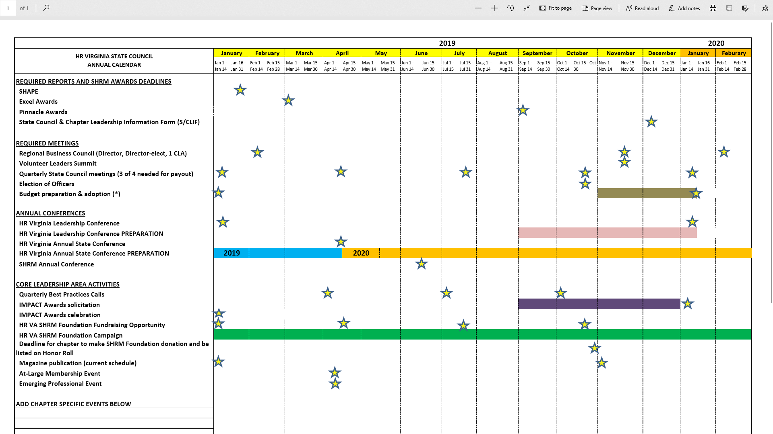

Slide 34
GOALS & FOCUS
AREA OF FOCUS
VALUE/BENEFIT TO CHAPTERS
Annual conference
Leadership conference
SHRM
SHRM Foundation
Service/support to Chapters
Numerous, source of funds
Prepare & educate leaders
Resources, $$, leadership, focus
Resources, scholarships
What they need…and when from CLA’s, Functional & District Directors

Slide 35
STRATEGY # 1: INTERNAL FOCUS SUPPORT/DEVELOP A Framework for decision-making, COUNCIL operational support, & corporate PARTNER and sponsorships
Deliver value, allow for focus and support
Strategy # 2: EXTERNAL FOCUS KEEPING VASHRM relevant in the face of multiple competing priorities and options
Continue to attract members, identify successors, develop leaders

Slide 36
HELP WANTED –
STATE COUNCIL MEMBERS
Talk to Michael or Betty
2020 CONFERENCE COMMITTEE MEMBERS
Talk to Gail, Josie or Deron

